Slide 1
ANN for Concrete Strength prediction

Slide 2
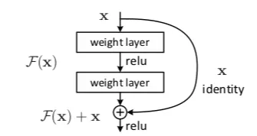
Residual Neural Network (ResNet)
For including more features and deeper network
Solving the vanishing gradient problem

Slide 3
Residual Neural Network
Regular ANN vs ResNet
Using more hidden layers
Using entire features of US dataset
Activation function: Hyperbolic tangent
Loss function: Mean square error

Slide 4
Residual Neural Network
Adjusting delta of loss value between epoch
Adding layers
Different structure (ResNet vs ANN)

Slide 5
Neural Network
 | R2 (new setting) | R2（original setting)
ResNet6 | 0.692 | 0.681
ResNet18 | 0.697 | 0.689
ANN (6 layers) | 0.692 | 0.685
ANN (18 layers) | 0.697 | 0.689

